Slide 1

SEEQs
End-of- semester Feedback
Please take the first 10 minutes of class to complete the SEEQs for this course.
Mon. April. 14 to Sun. May 4 until 11:59 pm
Notes:
Student Educational Experience Questionnaire (SEEQ)
Wait outside the classroom because students will feel pressure if you are in the room.
“Your feedback is important because it helps me understand experience of the course and make changes to improve it for future students.”
“I want to hear from you whether your feedback is positive, neutral, or negative.”
“Your responses help me understand how feel about your engagement with the material, other students, and me.”
“In the past, I’ve made changes to (provide examples to students) based on student feedback.”

Slide 2
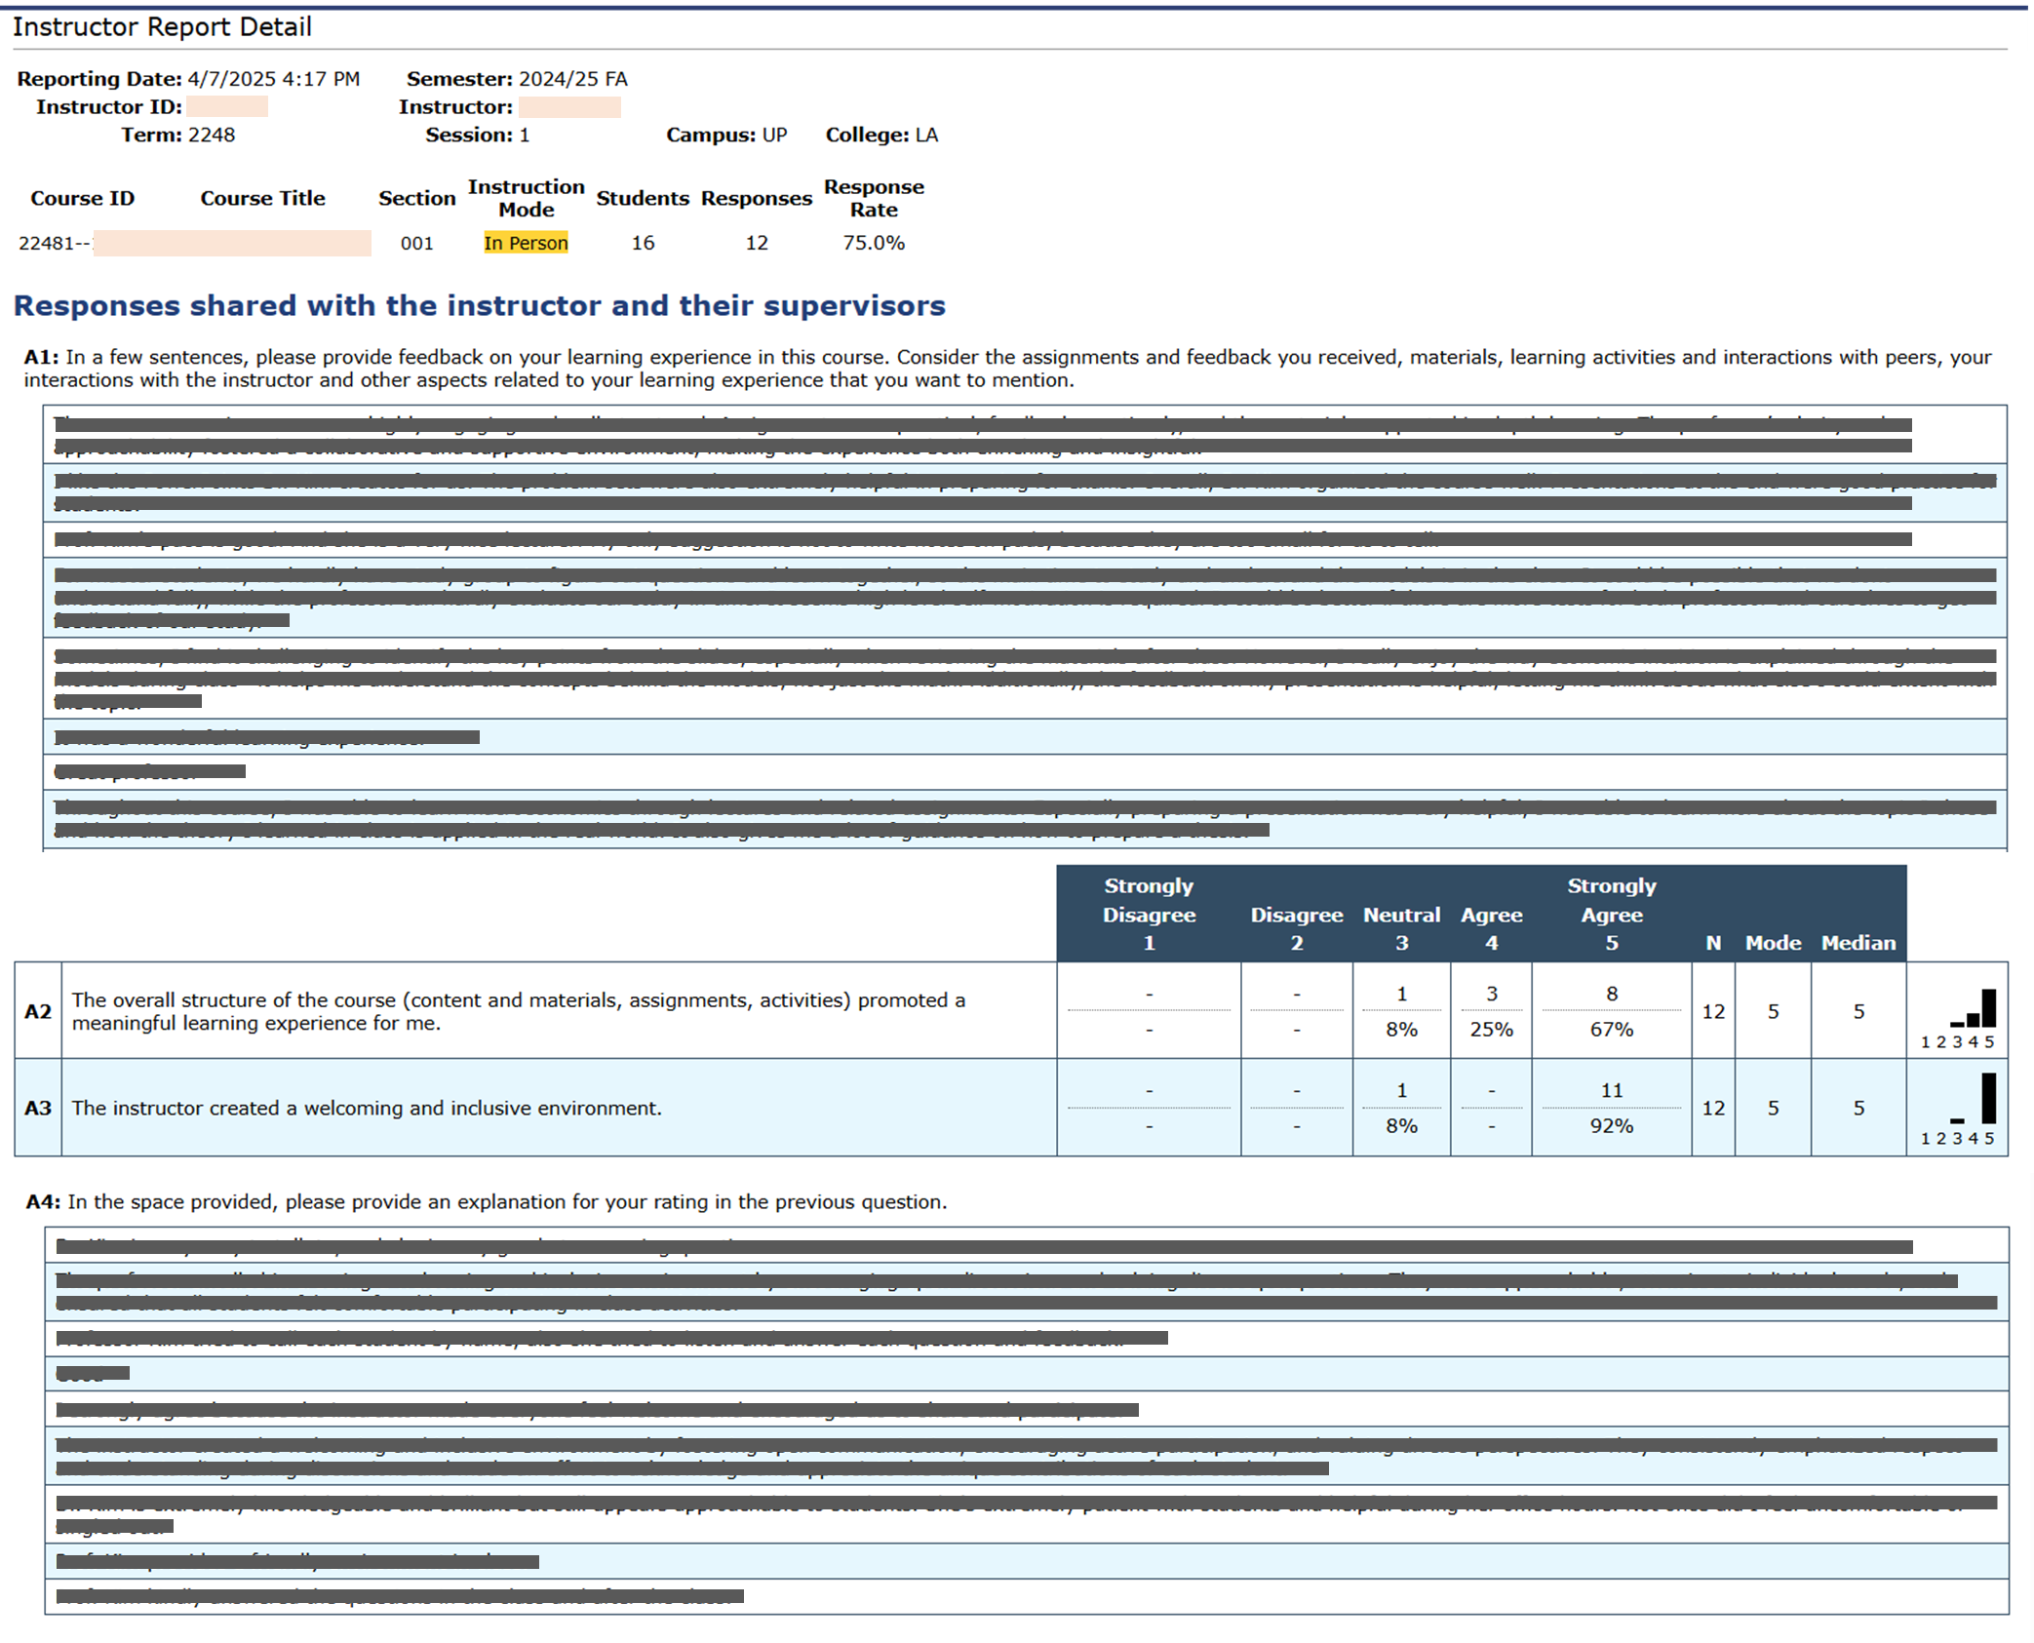
Notes:
Above is a screenshot of a real SEEQ Report, with the student feedback blocked out. Students may be relieved to see a report because it shows that their responses are aggregated and thus anonymous. Each row in the written feedback table represents a different student. Students do not necessarily fill out both A1 and A4, so the 3rd row for each table are not necessarily from the same student.
Because only some students responded to first and fourth items, the first comments (or 5th comments, etc.) are unlikely to be the same student.

